Slide 1


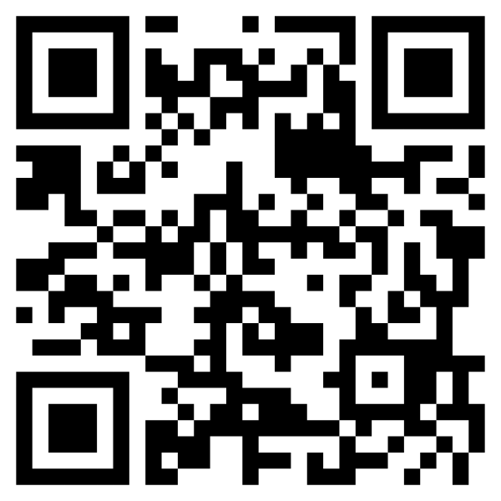


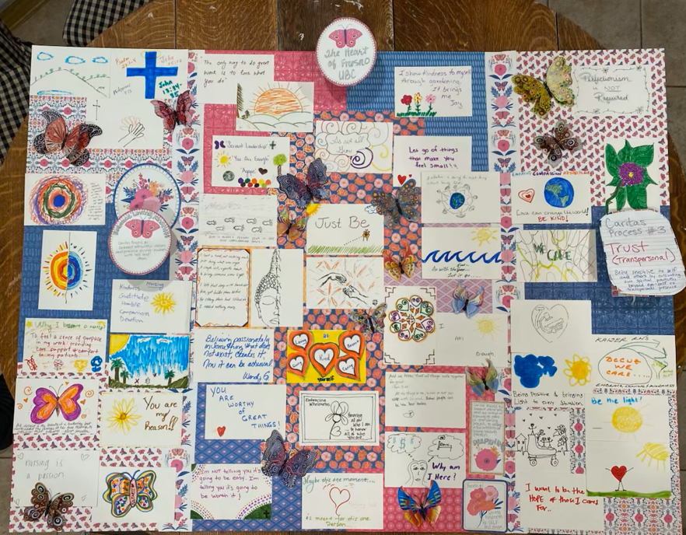

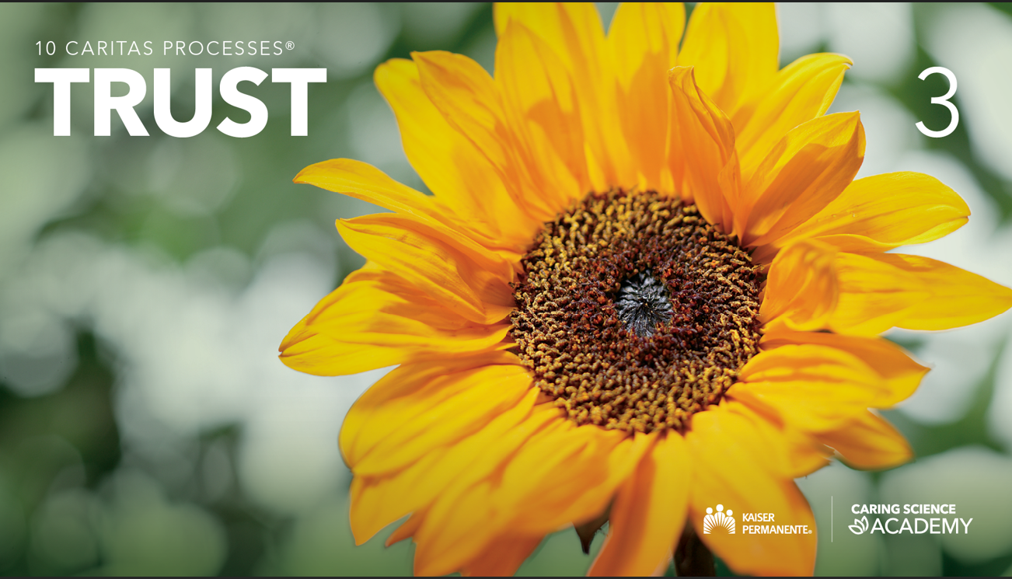

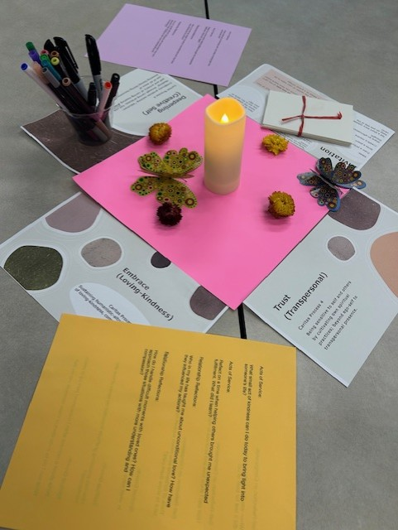

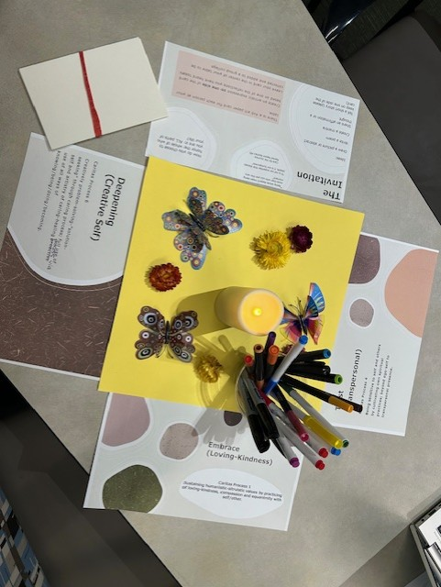
Background
Grounded in Watson’s Theory of Human Caring, this project operationalized specific Caritas Processes® in practice. The author is a registered nurse who supports well-being through self-awareness, building healing relationships with guided reflection, centering moments, and, most importantly, the relationship we have with ourselves.
Relevance/Significance
Burnout among nurses has been a persistent issue with significantly increasing trends, but it has become more pronounced in recent decades due to factors like increased patient loads, administrative tasks, and insufficient staffing. CDC has designed a new intervention to create healthier healthcare workplaces called Impact Wellbeing (Wickstrom, 2023). Therefore, the aim was to contribute to wellbeing positively through cultivating Caritas® consciousness.
Purpose
This project was created to cultivate a safe, trusting space between the RN and the Unit Council members and leaders. The authors integrated mindfulness modalities such as centering moments, guided reflection, and creative artwork. This project is intended to provide nursing professional governance council members with micro-practices and a message to honor oneself to support healing relationships.
Results
The expressions of creativity were compiled and added to a display board as a reminder of the reflective time, honoring the relationship with self, and building healthy relationships for healing. Verbal feedback was obtained with some council members stating remarks of gratitude, and some asked how they could become a Caritas Coach®. Some council members stated that the time was “very special and impactful”. The creative expressions were presented at the next unit council day and shared the collage of artwork. Participants were surveyed and asked how they would incorporate these micro practices into their routine. 93% of respondents rated this activity as very helpful. Themes were drawn such as eating healthier, slow deep breaths, gardening, and exercise. A one-month post-implementation survey was sent to measure whether the micro-practices were sustained. 77% of respondents completed the survey and marked “yes” to sustaining the mindful practices. The combination of verbal feedback and surveys provided future implications and applications of this work. Overall, highly positive feedback was given, encouraging the continuation of mindful practices.
Outcome
Micro-practices of Caritas® consciousness, when intentionally embedded into governance structures, have the potential to transform professional culture from within.
Future Directions:
All healing modalities used will continue to be integrated into the unit council’s professional governance day. The aim is to begin with a centering moment each time.
Acknowledgements:
Great admiration and gratitude to my Caritas Coach® advisors:
Janet Sohal, DNP, RN, NEA-BC, Caritas Coach®
Rayne Soriano, PhD., RN, NE-BC, FADLN, Caritas Coach® Leader
Trevor Murray, DNP, RN, NEA-BC, NI-BC
Glory Asuquo, DNP, RN, ONS/ONCC, Caritas Coach®
References
Gilmartin, H., Goyal, A., Hamati, M. C., Mann, J., Saint, S., & Chopra, V. (2017). Brief mindfulness practices for healthcare providers – A systematic literature review. American Journal of Medicine, 130(10), 1219.e1–1219.e7.
Watson, J. (2008) (revised edition) Nursing: The Philosophy and Science of Caring, University. Press of Colorado.
Wickstrom, A. (2023). CDC: Burnout Keeps Rising for Nurses and Other Healthcare Workers. https://nursejournal.org/articles/cdc-nurse-healthcare-worker-burnout/
Low-cost, easily replicable materials were used to facilitate sustainability and spread:
Nurse Scholars Academy
Caring Science Academy
Caritas Coach Education Program®
Creative Expressions:
Strategies and Implementation
Prepare the Space
    Centerpieces, Candles, Printed Caritas® Processes, Dim lighting
2. Guided Centering & Reflection
    Mindfulness experience delivered to ~70 council members
3. Introduce Caritas® Concepts.
  Highlight empathy, self‑awareness, and safe space. Discuss Caritas® and insights from the coaching program
4. Connect to Clinical Impact
    Patient outcomes
    Professional growth
    Compassionate care
    Culture
5. Creative Expression Activity (1 hour)
Art • Writing • Poetry • Mantras • Affirmations
CULTIVATING CARITAS® CONSCIOUSNESS USING CENTERING MICRO-PRACTICES AND GUIDED REFLECTIONS WITH CREATIVE EXPRESSIONS
Ann Bindra, DNP, RN, NEA-BC, NPD-BC, CCRN, Caritas Coach®
KP NCAL Regional Patient Care Services
Regional Magnet Program Director
Notes:
1. Embrace (Loving-Kindness) Sustaining humanistic-altruistic values by practicing loving-kindness, compassion and equanimity with self/others.
3. Trust (Transpersonal) Being sensitive to self and others by cultivating own spiritual practices; beyond ego-self to transpersonal presence.
4. Nurture
6. Deepen (Creative Self) Creatively problem-solving-solution-seeking' through caring process; full use of self and artistry of caring-healing practices via use of all ways of knowing/being/doing/becoming.
I wanted to cultivate Caritas consciousness and provide a meaningful experience for council members. The creative expressions make the impact tangible and human, which feels very aligned with the spirit of IAHC.

